Slide 1
Cell Organelles: Cell Membrane (Plasma Membrane)

Slide 2
Overview: Life at the Edge
The plasma membrane is the boundary that separates the living cell from its surroundings
The plasma membrane exhibits selective permeability, allowing some substances to cross it more easily than others
© 2011 Pearson Education, Inc.

Slide 3
Cellular membranes are fluid mosaics of lipids and proteins
Phospholipids are the most abundant lipid in the plasma membrane
Phospholipids are amphipathic molecules, containing hydrophobic and hydrophilic regions
The fluid mosaic model states that a membrane is a fluid structure with a “mosaic” of various proteins embedded in it
© 2011 Pearson Education, Inc.
Notes:
For the Cell Biology Video Structure of the Cell Membrane, go to Animation and Video Files.

Slide 4
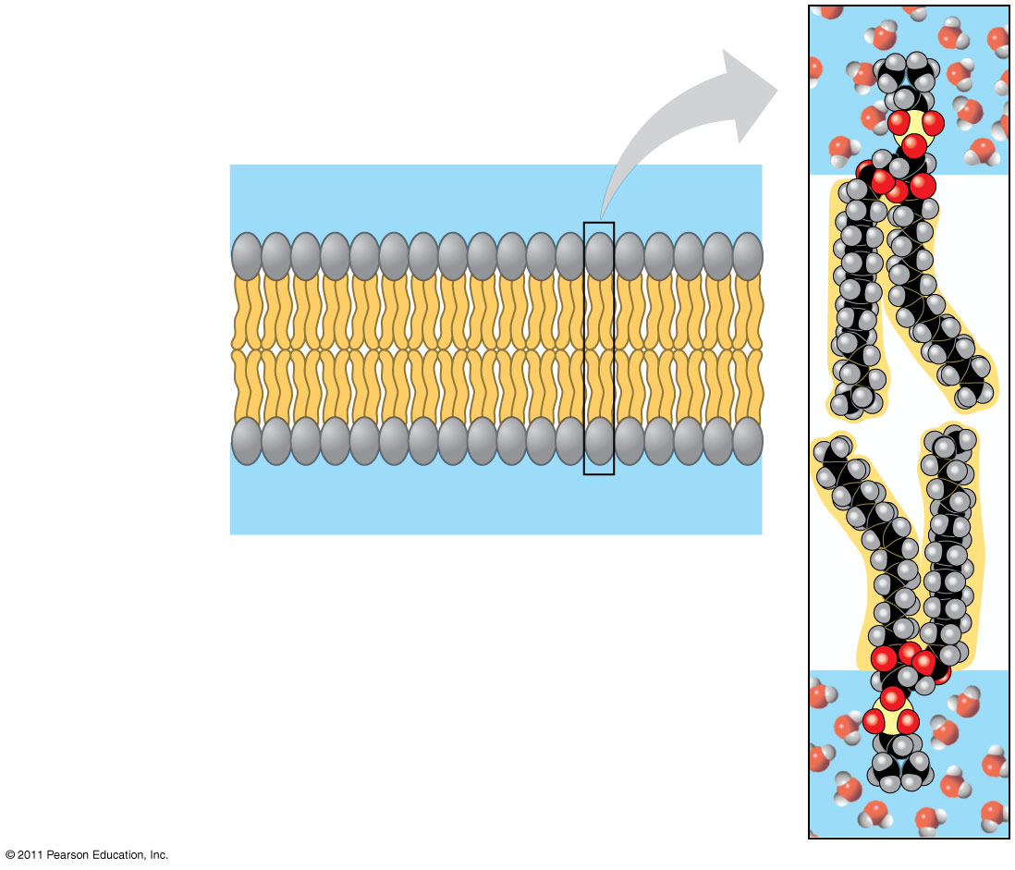
Figure 7.2
WATER
Hydrophilic head
Hydrophobic tail
WATER
Notes:
4
Figure 7.2 Phospholipid bilayer (cross section).

Slide 5
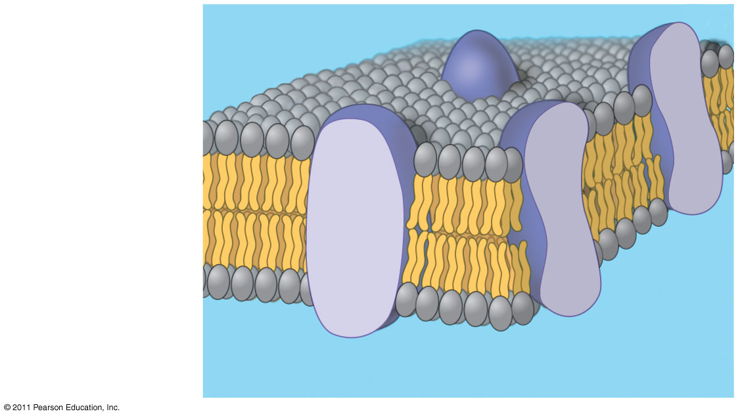
Figure 7.3
Phospholipid bilayer
Hydrophobic regions of protein
Hydrophilic regions of protein
Notes:
5
Figure 7.3 The original fluid mosaic model for membranes.

Slide 6
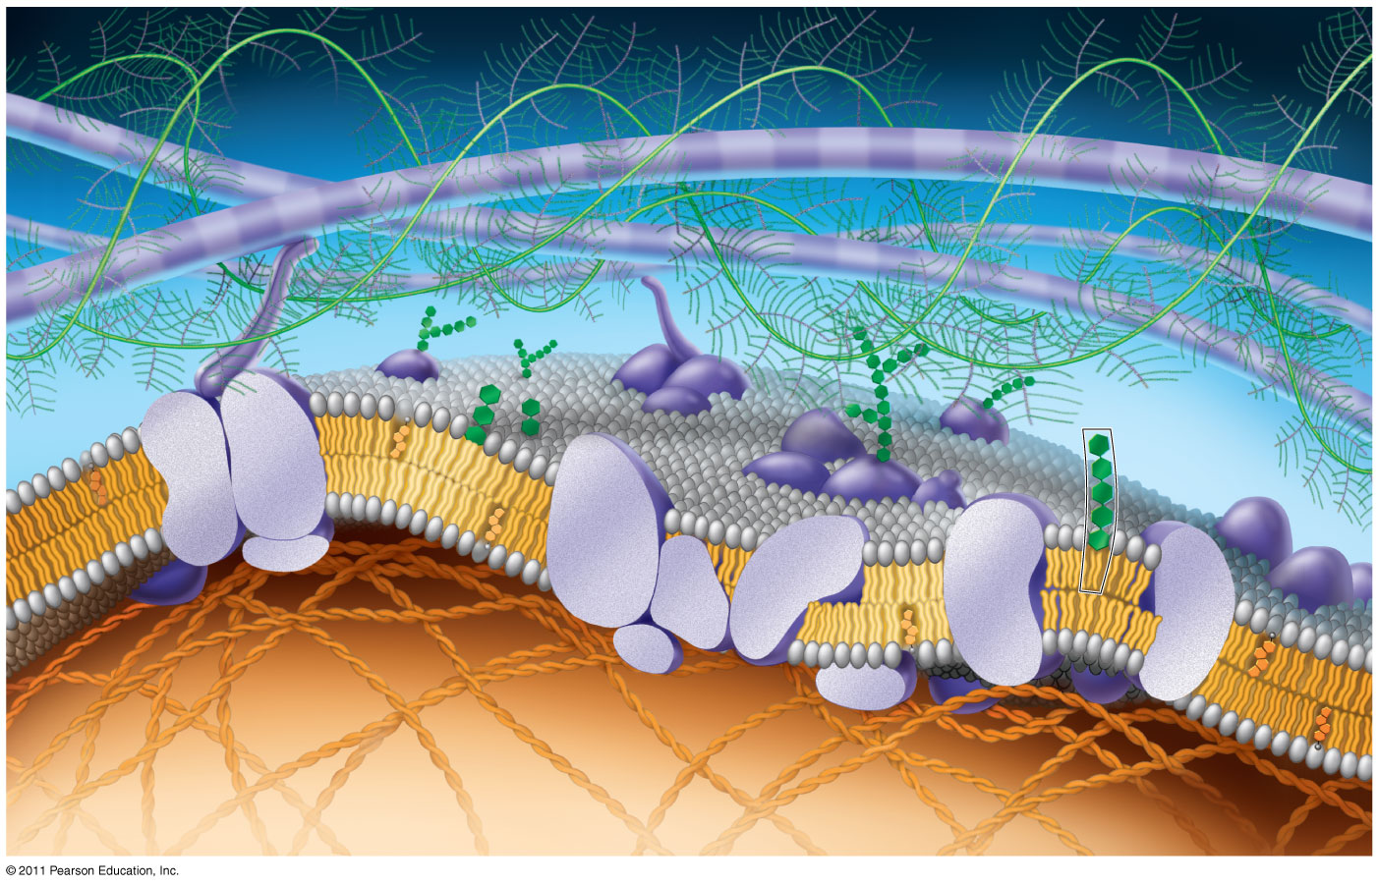
Figure 7.5
Fibers of extra- cellular matrix (ECM)
Glyco- protein
Carbohydrate
Glycolipid
EXTRACELLULAR SIDE OF MEMBRANE
Cholesterol
Microfilaments of cytoskeleton
Peripheral proteins
Integral protein
CYTOPLASMIC SIDE OF MEMBRANE
Notes:
6
Figure 7.5 Updated model of an animal cell’s plasma membrane (cutaway view).

Slide 7
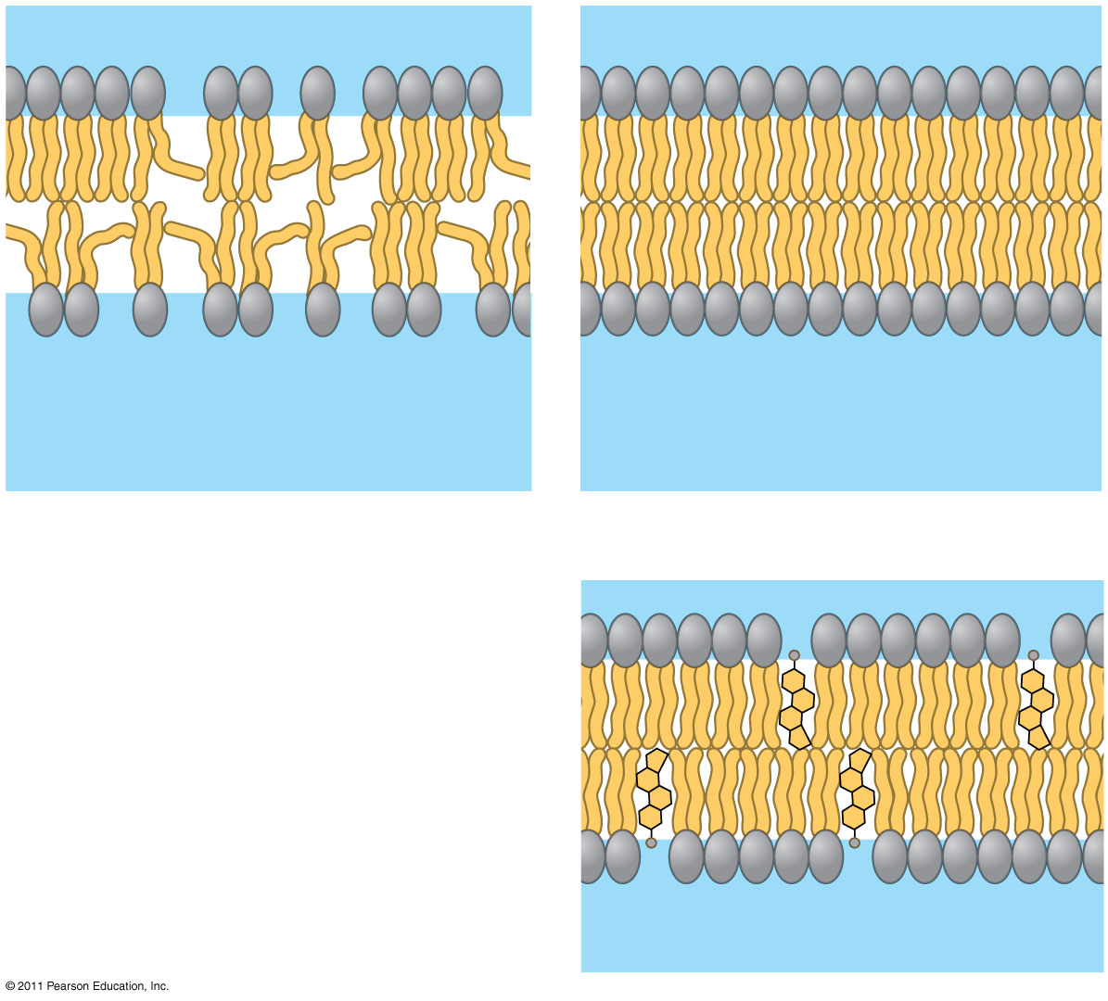
Figure 7.8
Fluid
Viscous
Unsaturated hydrocarbon tails
Saturated hydrocarbon tails
(a) Unsaturated versus saturated hydrocarbon tails
(b) Cholesterol within the animal cell membrane
Cholesterol
Notes:
7
Figure 7.8 Factors that affect membrane fluidity.

Slide 8
Membrane Proteins and Their Functions
A membrane is a collage of different proteins, often grouped together, embedded in the fluid matrix of the lipid bilayer
Proteins determine most of the membrane’s specific functions
© 2011 Pearson Education, Inc.

Slide 9
Peripheral proteins are bound to the surface of the membrane
Integral proteins penetrate the hydrophobic core
Integral proteins that span the membrane are called transmembrane proteins
The hydrophobic regions of an integral protein consist of one or more stretches of nonpolar amino acids, often coiled into alpha helices
© 2011 Pearson Education, Inc.

Slide 10
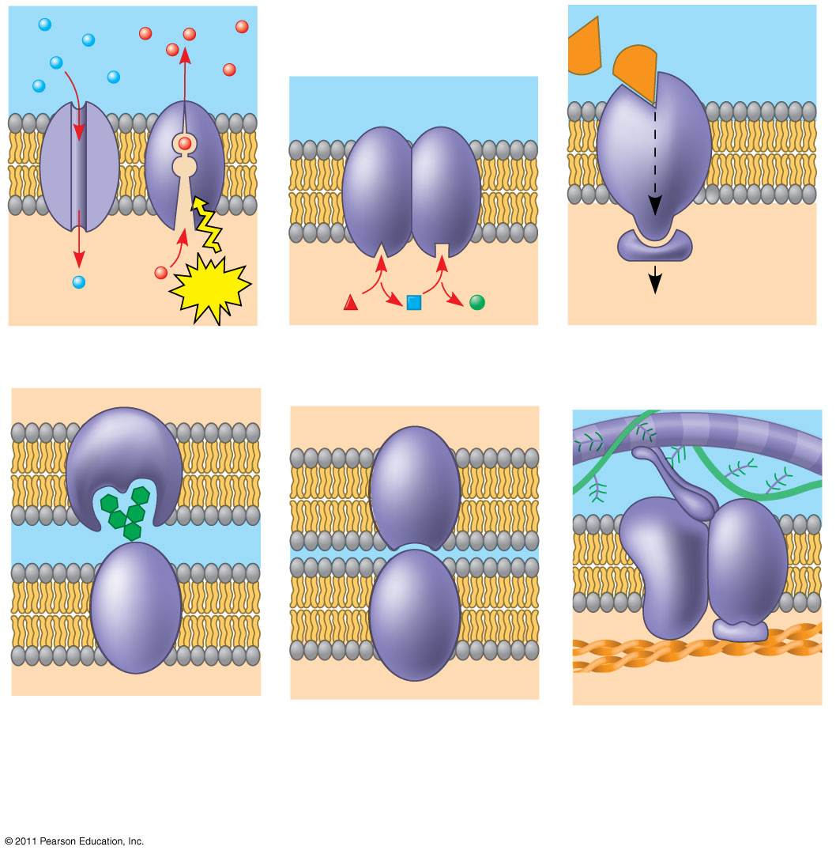
Figure 7.10
Signaling molecule
Enzymes
Receptor
ATP
Signal transduction
(a) Transport
(b) Enzymatic activity
(c) Signal transduction
Glyco- protein
(d) Cell-cell recognition
(e) Intercellular joining
(f) Attachment to the cytoskeleton and extracellular matrix (ECM)
Notes:
10
Figure 7.10 Some functions of membrane proteins.

Slide 11
The Role of Membrane Carbohydrates in Cell-Cell Recognition
Cells recognize each other by binding to surface molecules, often containing carbohydrates, on the extracellular surface of the plasma membrane
Membrane carbohydrates may be covalently bonded to lipids (forming glycolipids) or more commonly to proteins (forming glycoproteins)
Carbohydrates on the external side of the plasma membrane vary among species, individuals, and even cell types in an individual
© 2011 Pearson Education, Inc.

Slide 12
Membrane structure results in selective permeability
A cell must exchange materials with its surroundings, a process controlled by the plasma membrane
Plasma membranes are selectively permeable, regulating the cell’s molecular traffic
© 2011 Pearson Education, Inc.

Slide 13
The Permeability of the Lipid Bilayer
Hydrophobic (nonpolar) molecules, such as hydrocarbons, can dissolve in the lipid bilayer and pass through the membrane rapidly
Polar molecules, such as sugars, do not cross the membrane easily
© 2011 Pearson Education, Inc.

Slide 14
Transport Proteins
Transport proteins allow passage of hydrophilic substances across the membrane
Some transport proteins, called channel proteins, have a hydrophilic channel that certain molecules or ions can use as a tunnel
Channel proteins called aquaporins facilitate the passage of water
© 2011 Pearson Education, Inc.

Slide 15
Passive transport is diffusion of a substance across a membrane with no energy investment
Diffusion is the tendency for molecules to spread out evenly into the available space
Although each molecule moves randomly, diffusion of a population of molecules may be directional
At dynamic equilibrium, as many molecules cross the membrane in one direction as in the other
© 2011 Pearson Education, Inc.

Slide 16
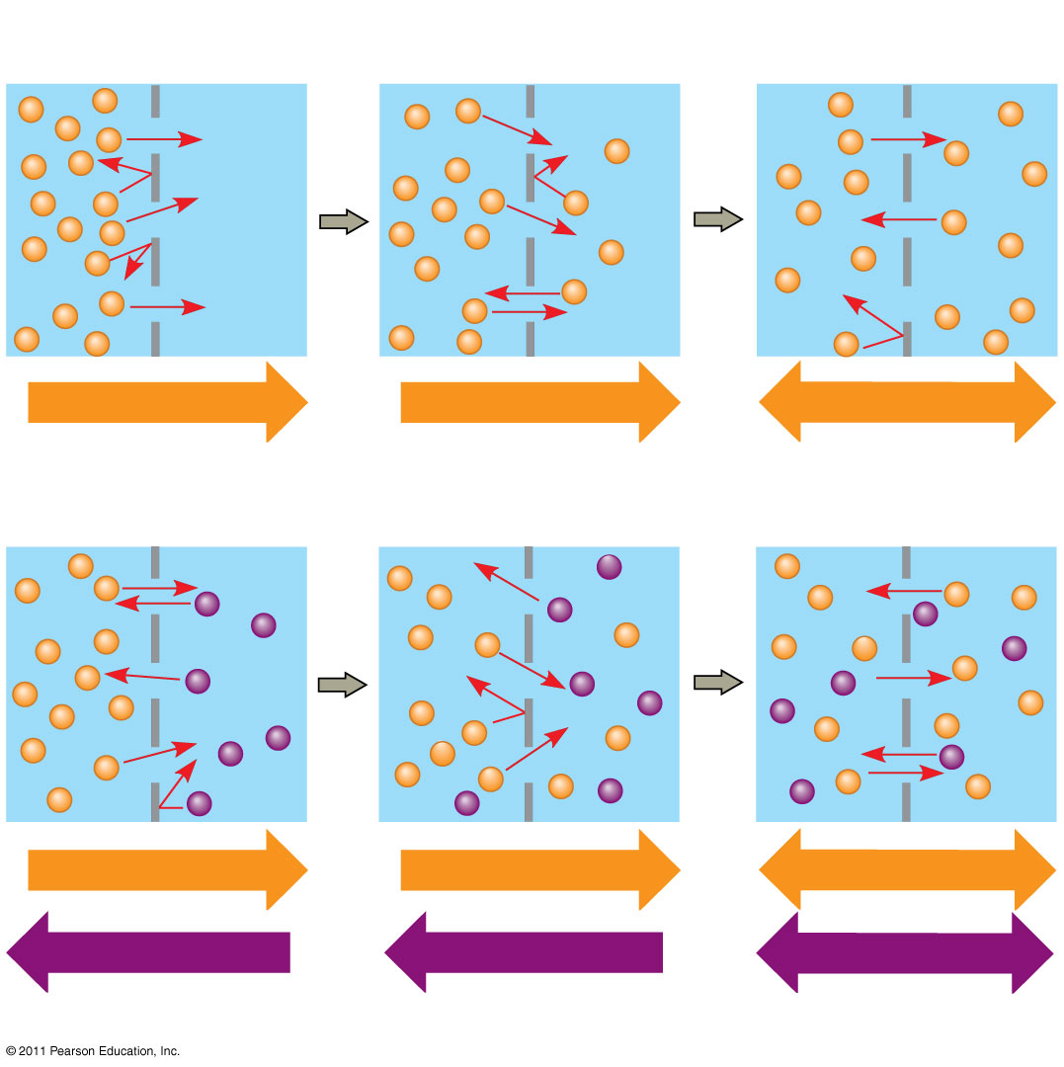
Figure 7.13
Molecules of dye
Membrane (cross section)
WATER
Net diffusion
Net diffusion
Equilibrium
(a) Diffusion of one solute
Net diffusion
Net diffusion
Equilibrium
Net diffusion
Net diffusion
Equilibrium
(b) Diffusion of two solutes
Notes:
16
Figure 7.13 The diffusion of solutes across a synthetic membrane.

Slide 17
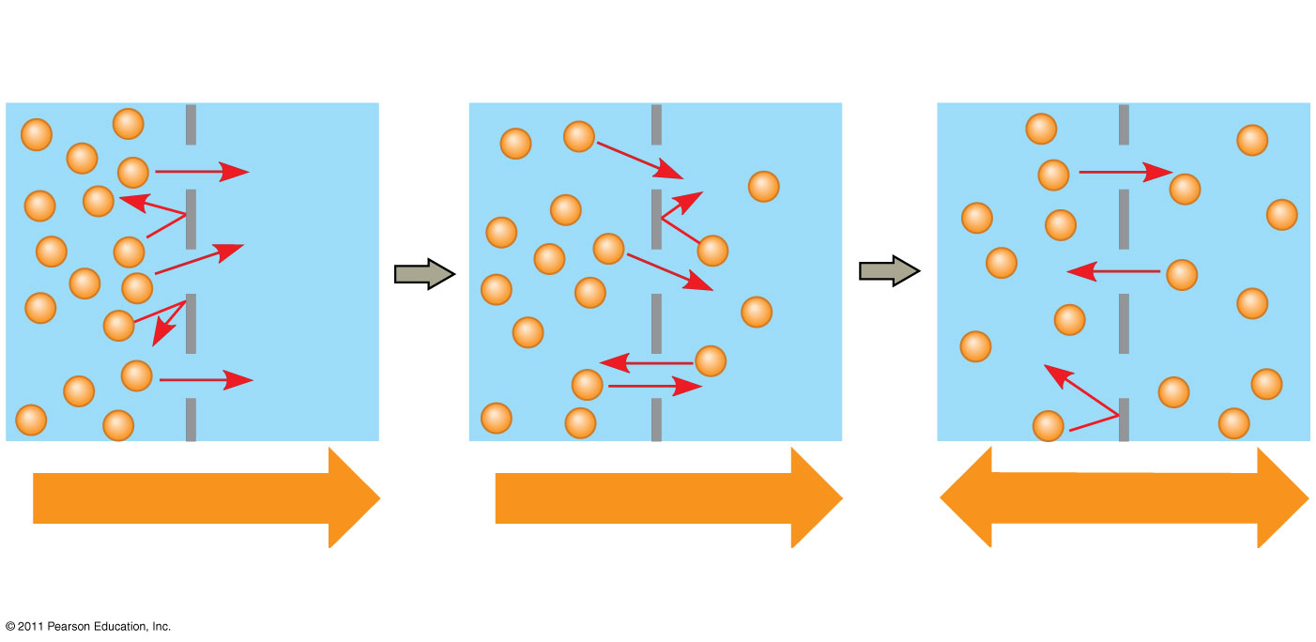
Figure 7.13a
Molecules of dye
Membrane (cross section)
WATER
Net diffusion
Net diffusion
Equilibrium
(a) Diffusion of one solute
Notes:
17
Figure 7.13 The diffusion of solutes across a synthetic membrane.

Slide 18
Substances diffuse down their concentration gradient, the region along which the density of a chemical substance increases or decreases
No work must be done to move substances down the concentration gradient
The diffusion of a substance across a biological membrane is passive transport because no energy is expended by the cell to make it happen
© 2011 Pearson Education, Inc.

Slide 19
Effects of Osmosis on Water Balance
Osmosis is the diffusion of water across a selectively permeable membrane
Water diffuses across a membrane from the region of lower solute concentration to the region of higher solute concentration until the solute concentration is equal on both sides
© 2011 Pearson Education, Inc.

Slide 20
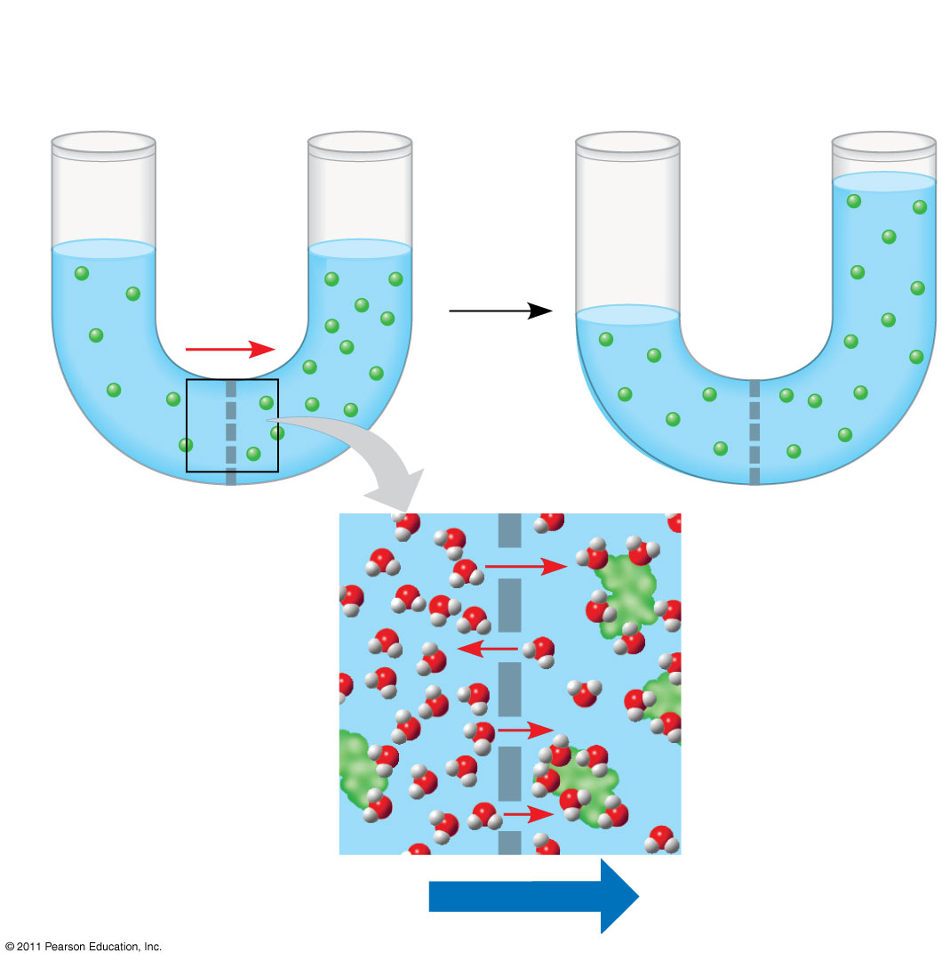
Figure 7.14
Lower concentration of solute (sugar)
Higher concentration of solute
Same concentration of solute
Sugar molecule
H₂O
Selectively permeable membrane
Osmosis
Notes:
20
Figure 7.14 Osmosis.

Slide 21
Water Balance of Cells Without Walls
Tonicity is the ability of a surrounding solution to cause a cell to gain or lose water
Isotonic solution: Solute concentration is the same as that inside the cell; no net water movement across the plasma membrane
Hypertonic solution: Solute concentration is greater than that inside the cell; cell loses water
Hypotonic solution: Solute concentration is less than that inside the cell; cell gains water
© 2011 Pearson Education, Inc.

Slide 22
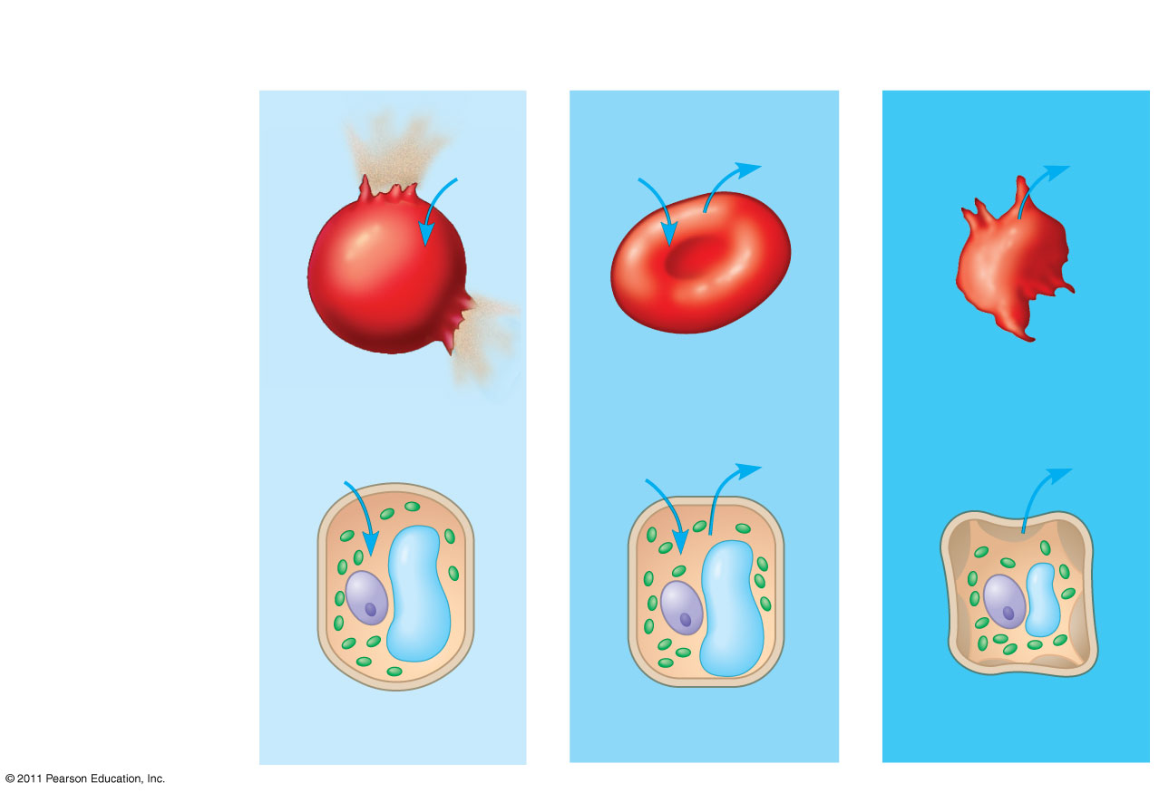
Figure 7.15
Hypotonic solution
Isotonic solution
Hypertonic solution
(a) Animal cell
H₂O
H₂O
H₂O
H₂O
Lysed
Normal
Shriveled
H₂O
Cell wall
H₂O
H₂O
H₂O
(b) Plant cell
Turgid (normal)
Flaccid
Plasmolyzed
Osmosis
Notes:
22
Figure 7.15 The water balance of living cells.

Slide 23
Water Balance of Cells with Walls
Cell walls help maintain water balance
A plant cell in a hypotonic solution swells until the wall opposes uptake; the cell is now turgid (firm)
If a plant cell and its surroundings are isotonic, there is no net movement of water into the cell; the cell becomes flaccid (limp), and the plant may wilt
© 2011 Pearson Education, Inc.

Slide 24
In a hypertonic environment, plant cells lose water; eventually, the membrane pulls away from the wall, a usually lethal effect called plasmolysis
© 2011 Pearson Education, Inc.

Slide 25
Facilitated Diffusion: Passive Transport Aided by Proteins
In facilitated diffusion, transport proteins speed the passive movement of molecules across the plasma membrane
Channel proteins provide corridors that allow a specific molecule or ion to cross the membrane
Channel proteins include
Aquaporins, for facilitated diffusion of water
Ion channels that open or close in response to a stimulus (gated channels)
© 2011 Pearson Education, Inc.
Notes:
For the Cell Biology Video Water Movement through an Aquaporin, go to Animation and Video Files.

Slide 26
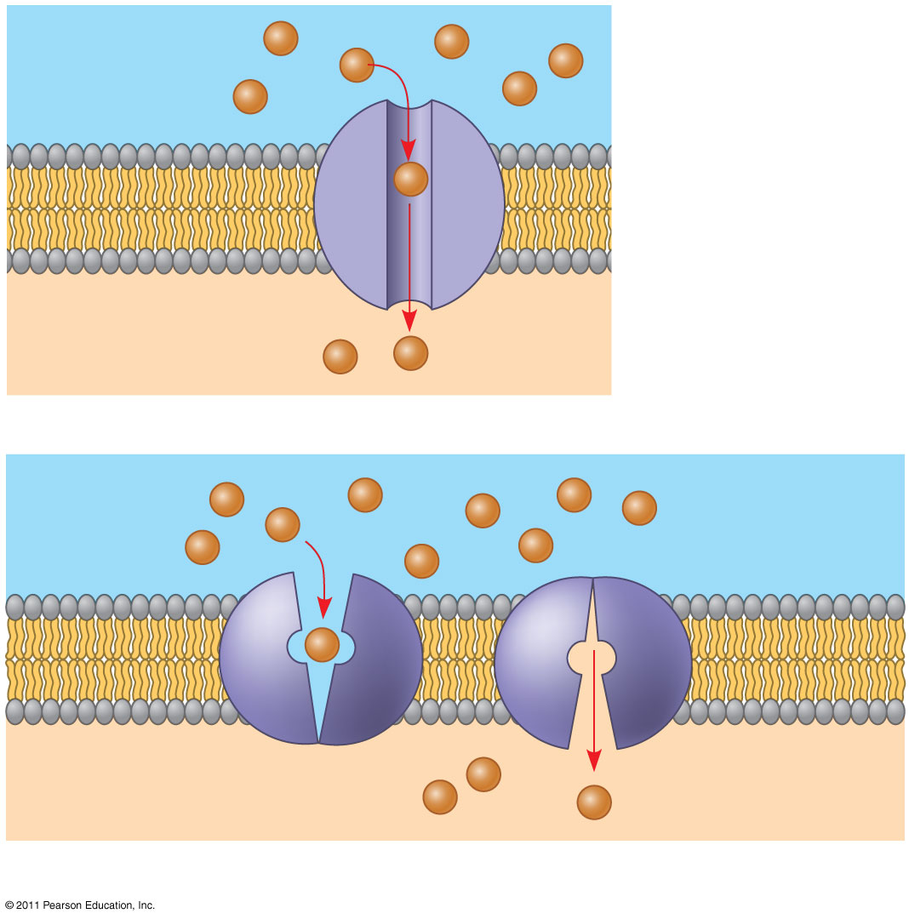
Figure 7.17
EXTRACELLULAR FLUID
(a) A channel protein
Channel protein
Solute
CYTOPLASM
Carrier protein
Solute
(b) A carrier protein
Notes:
26
Figure 7.17 Two types of transport proteins that carry out facilitated diffusion.

Slide 27
Active transport uses energy to move solutes against their gradients
Facilitated diffusion is still passive because the solute moves down its concentration gradient, and the transport requires no energy
Some transport proteins, however, can move solutes against their concentration gradients
© 2011 Pearson Education, Inc.

Slide 28
The Need for Energy in Active Transport
Active transport moves substances against their concentration gradients
Active transport requires energy, usually in the form of ATP
Active transport is performed by specific proteins embedded in the membranes
© 2011 Pearson Education, Inc.

Slide 29
Active transport allows cells to maintain concentration gradients that differ from their surroundings
The sodium-potassium pump is one type of active transport system
© 2011 Pearson Education, Inc.
Notes:
For the Cell Biology Video Na⁺/K⁺ATPase Cycle, go to Animation and Video Files.

Slide 30
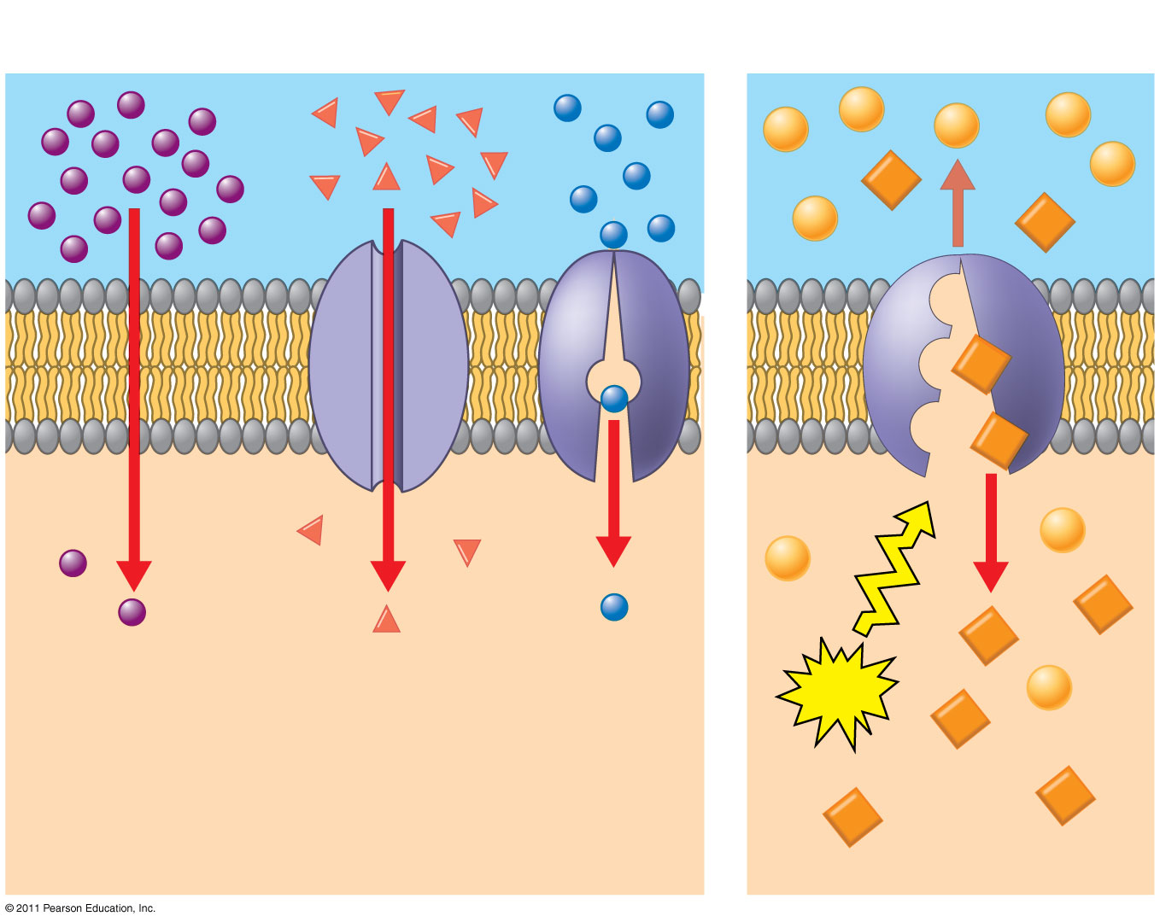
Figure 7.19
Passive transport
Active transport
Diffusion
Facilitated diffusion
ATP
Notes:
30
Figure 7.19 Review: passive and active transport.

Slide 31
Bulk transport across the plasma membrane occurs by exocytosis and endocytosis
Small molecules and water enter or leave the cell through the lipid bilayer or via transport proteins
Large molecules, such as polysaccharides and proteins, cross the membrane in bulk via vesicles
Bulk transport requires energy
© 2011 Pearson Education, Inc.

Slide 32
Exocytosis
In exocytosis, transport vesicles migrate to the membrane, fuse with it, and release their contents
Many secretory cells use exocytosis to export their products
© 2011 Pearson Education, Inc.

Slide 33
Endocytosis
In endocytosis, the cell takes in macromolecules by forming vesicles from the plasma membrane
Endocytosis is a reversal of exocytosis, involving different proteins
There are three types of endocytosis
Phagocytosis (“cellular eating”)
Pinocytosis (“cellular drinking”)
Receptor-mediated endocytosis
© 2011 Pearson Education, Inc.

Slide 34
In phagocytosis a cell engulfs a particle in a vacuole
The vacuole fuses with a lysosome to digest the particle
© 2011 Pearson Education, Inc.
Notes:
For the Cell Biology Video Phagocytosis in Action, go to Animation and Video Files.

Slide 35
In pinocytosis, molecules are taken up when extracellular fluid is “gulped” into tiny vesicles
© 2011 Pearson Education, Inc.

Slide 36
In receptor-mediated endocytosis, binding of ligands to receptors triggers vesicle formation
A ligand is any molecule that binds specifically to a receptor site of another molecule
© 2011 Pearson Education, Inc.

Slide 37
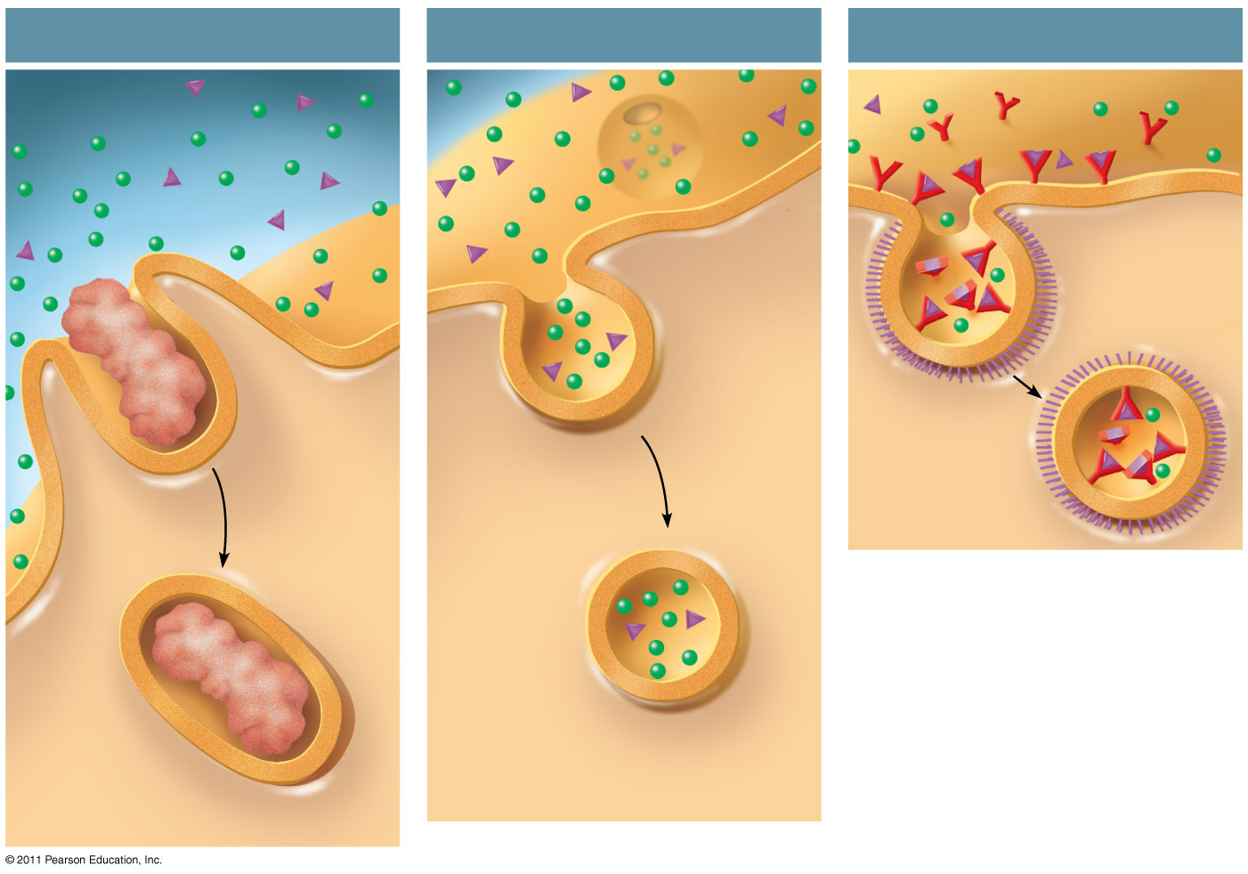
Figure 7.22
Phagocytosis
Pinocytosis
Receptor-Mediated Endocytosis
EXTRACELLULAR FLUID
Solutes
Pseudopodium
Receptor
Plasma membrane
Ligand
Coat proteins
Coated pit
“Food” or other particle
Coated vesicle
Vesicle
Food vacuole
CYTOPLASM
Notes:
37
Figure 7.22 Exploring: Endocytosis in Animal Cells

Slide 38
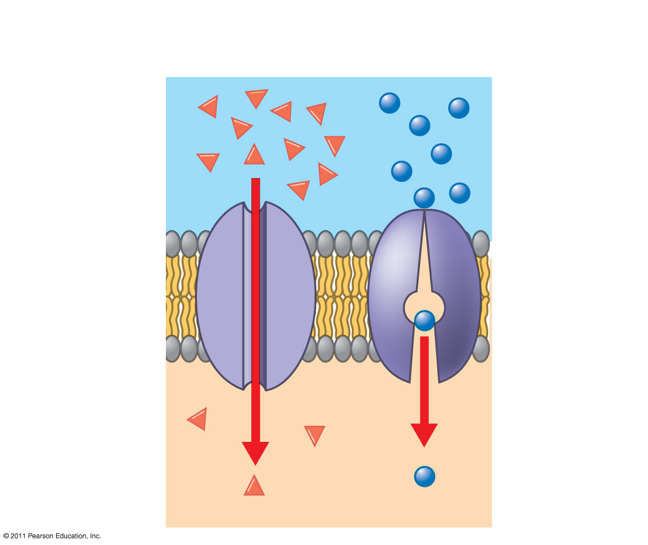
Figure 7.UN01
Passive transport: Facilitated diffusion
Channel protein
Carrier protein
Notes:
38
Figure 7.UN01 Summary figure, Concept 7.3

Slide 39
Figure 7.UN01
Passive transport: Facilitated diffusion
Channel protein
Carrier protein
Notes:
39
Figure 7.UN01 Summary figure, Concept 7.3

