Slide 1
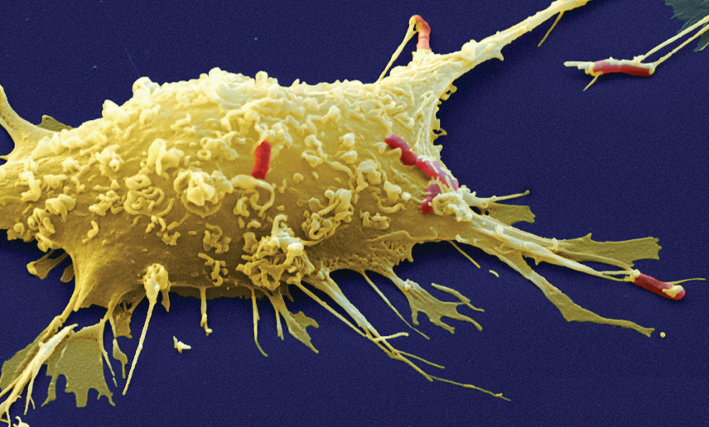
KEY CONCEPT Eukaryotic cells share many similarities.

Slide 2
MAIN IDEAS
Cells have an internal structure.
Several organelles are involved in making and processing proteins.
Other organelles have various functions.
Plant cells have cell walls and chloroplasts

Slide 3
WORDS TO KNOW
Cytoplasm
Cytoskeleton
Nucleus
Endoplasmic Reticulum
Ribosome
Vesicle
Mitochondria
Vacuole
Lysosome
Centriole
Cell Wall
Chloroplast
Golgi Apparatus
Cell Membrane

Slide 4
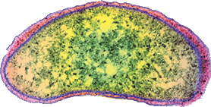
Prokaryotic cells lack a nucleus and most internal structures of eukaryotic cells.
All cells share certain characteristics.
Cells tend to be microscopic.
All cells are enclosed by a membrane.
All cells are filled with cytoplasm (is a jellylike substance that contains dissolved molecular building blocks—such as proteins, nucleic acids, minerals, and ions.)
cell membrane
cytoplasm
Bacterium
(colored SEM; magnification 8800x)

Slide 5
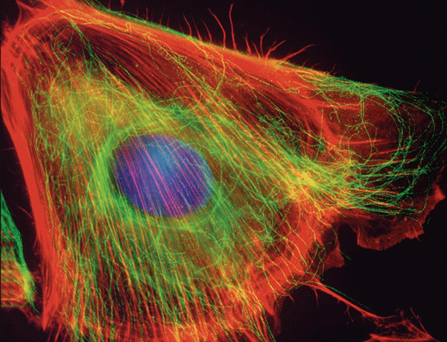
Cells have an internal structure.
The cytoskeleton has many functions.
supports and shapes cell
helps position and transport organelles
provides strength
assists in cell division
aids in cell movement

Slide 6
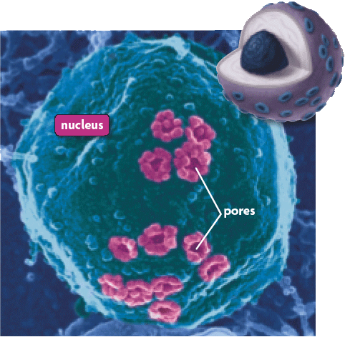
Several organelles are involved in making and processing proteins.
The nucleus stores genetic information.

Slide 7
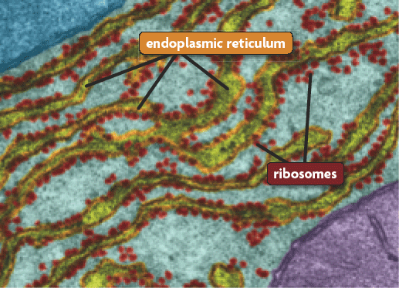
Several organelles are involved in making and processing proteins.
The nucleus stores genetic information.
Many processes occur in the endoplasmic reticulum.

Slide 8
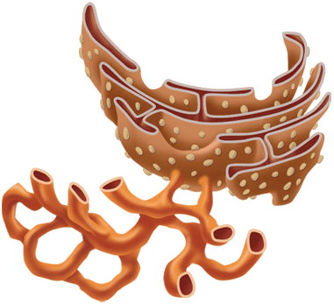
Several organelles are involved in making and processing proteins.
The nucleus stores genetic information.
Many processes occur in the endoplasmic reticulum.
There are two types of endoplasmic reticulum.
rough endoplasmic reticulum- produces protein
smooth endoplasmic reticulum- produces lipids.

Slide 9
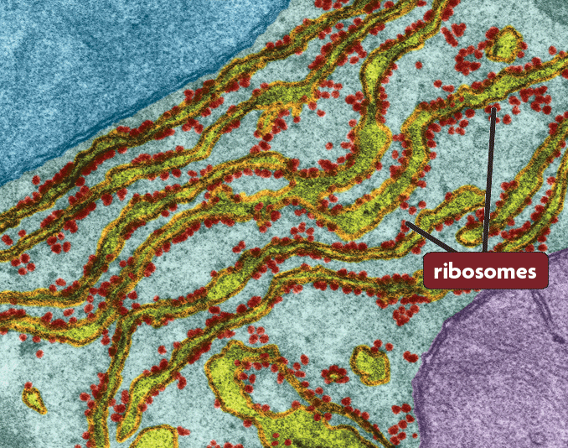
Several organelles are involved in making and processing proteins. (continued)
Ribosomes link amino acids to form proteins.

Slide 10
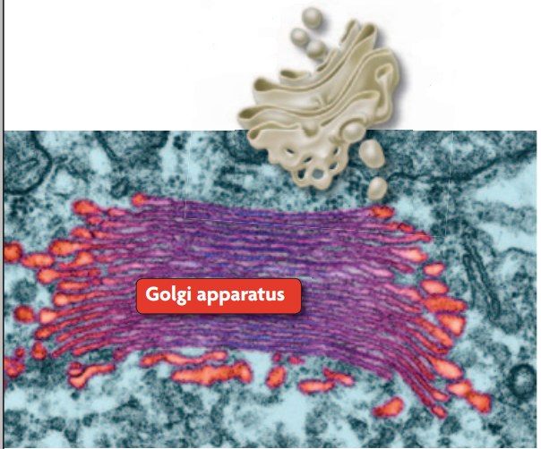
Several organelles are involved in making and processing proteins. (continued)
Golgi apparatus process, sort, and deliver proteins.

Slide 11
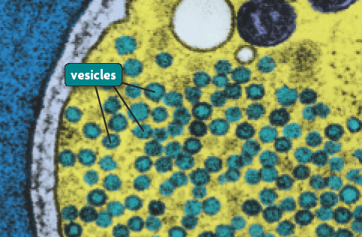
Several organelles are involved in making and processing proteins. (continued)
Vesicles are membrane-bound sacs that hold materials.

Slide 12
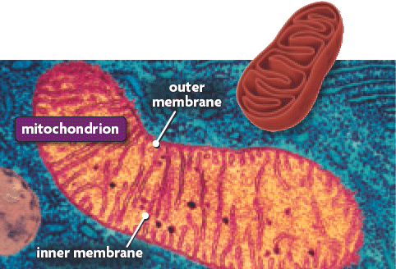
Other organelles have various functions.
Mitochondria supply energy to the cell.
The mitochondria has two membrane, with in these inner folds and compartments, a series of chemical reactions converts molecules from the food you eat into usable energy

Slide 13
Some organelles are similar in structure.
Mitochondria, Golgi apparatus and the Endoplasmic reticulum are composed of membrane-enclosed chambers. The surface area of each is greatly increased by folds and layers.

Slide 14
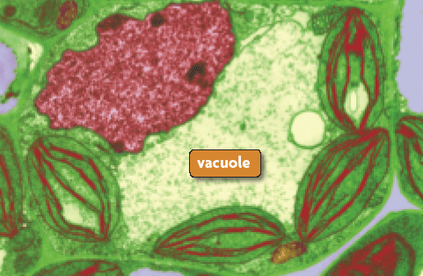
Other organelles have various functions.
Vacuoles are fluid-filled sacs that hold materials.

Slide 15
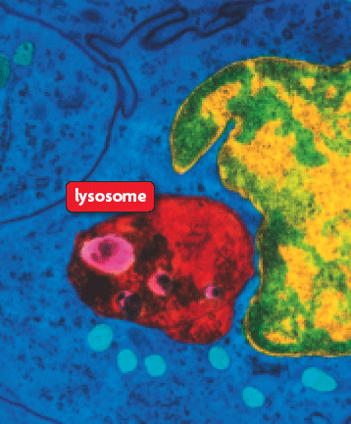
Other organelles have various functions.
Lysosomes contain enzymes to digest material.

Slide 16
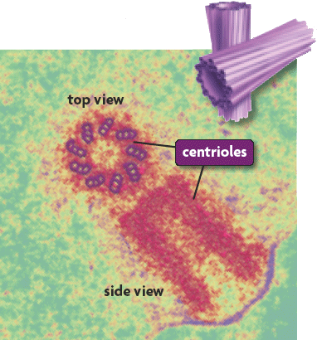
Other organelles have various functions.
Centrioles are tubes found in the centrosomes.
Centrioles help divide DNA.
Centrioles form cilia and flagella.

Slide 17
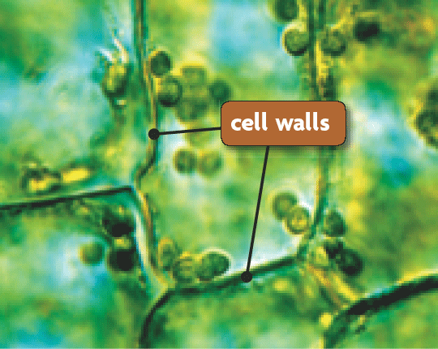
Plant cells have cell walls and chloroplasts.
A cell wall provides rigid support.

Slide 18
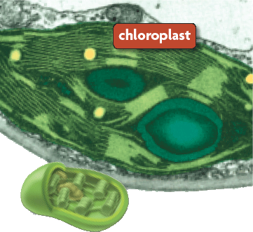
Plant cells have cell walls and chloroplasts.
A cell wall provides rigid support.
Chloroplasts convert solar energy to chemical energy.

Slide 19
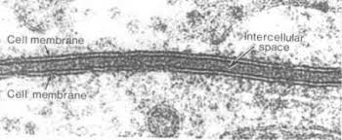
Plant and Animal cells have cell membrane.
Cell membrane also known as the plasma membrane, forms a boundary between a cell and the outside environment and controls the passage of materials into and out of a cell.

