Slide 1
KEY CONCEPT Enzymes are catalysts for chemical reactions in living things.

Slide 2
MAIN IDEAS
A catalyst lowers activation energy.
Enzymes allow chemical reactions to occur under tightly controlled conditions.

Slide 3
WORDS TO KNOW
Catalyst
Enzyme
Substrate
Active Site
Enzyme-Substrate Complex
Inhibitor
Activation Energy

Slide 4
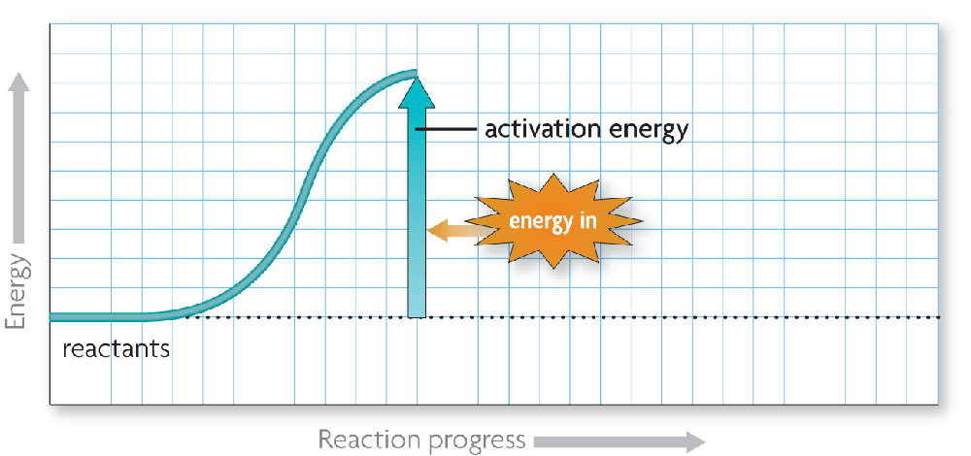
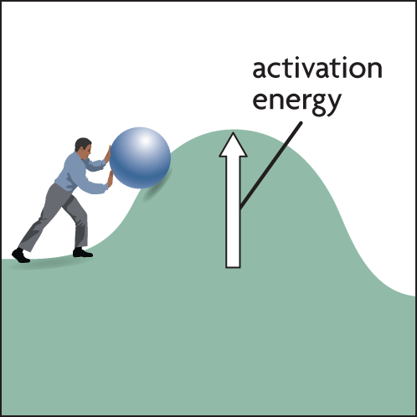
Chemical reactions release or absorb energy.
Activation energy is the amount of energy that needs to be absorbed to start a chemical reaction.

Slide 5
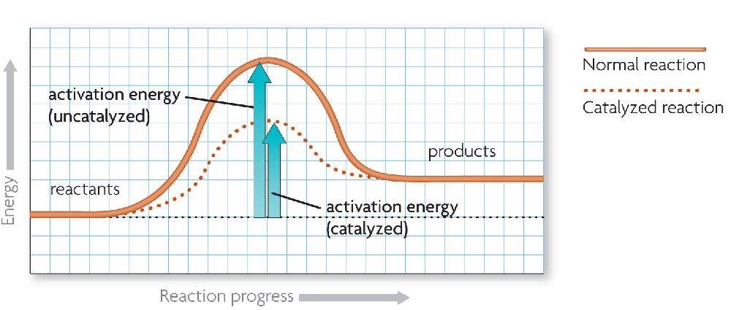
A catalyst lowers activation energy.
Catalysts are substances that speed up chemical reactions.
decrease activation energy
increase reaction rate

Slide 6
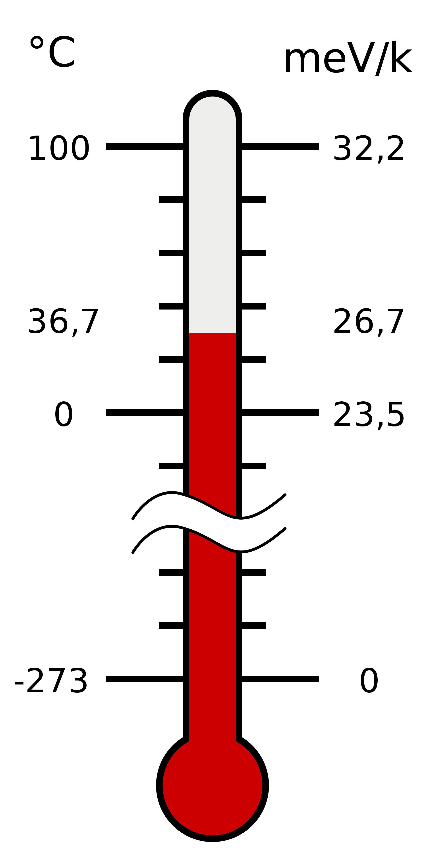
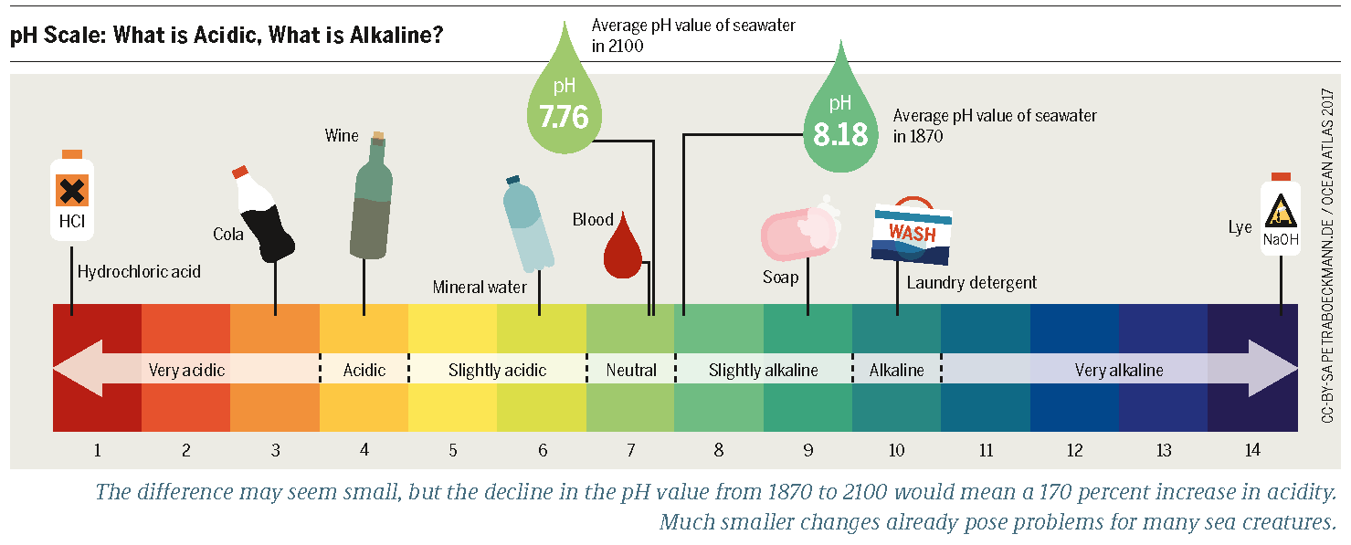
Enzymes act as catalyst.
Enzymes are catalysts in living things.
Enzymes are needed for almost all processes.
Food digestions (Lipase & Amylase)
Most enzymes are proteins.
Enzymes function best under optimal conditions
Temperature
pH

Slide 7
Notes:
Closer look and explanation of pH scale

Slide 8
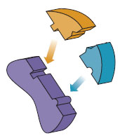
An enzyme’s structure allows only certain reactants to bind to the enzyme.
substrates
active site
substrates (reactants)
enzyme
Substrates bind to an enzyme at certain places called active sites.

Slide 9
The lock-and-key model helps illustrate how enzymes function.
substrates brought together
bonds in substrates weakened
Substrates bind to an enzyme at certain places called active sites.
The enzyme brings substrates together and weakens their bonds.
The catalyzed reaction forms a product that is released from the enzyme.

Slide 10
The temporary molecule formed when an enzyme comes into perfect contact with its substrate is called an Enzyme Substrate Complex.
Substrates bind to an enzyme at certain places called active sites.
The enzyme brings substrates together and weakens their bonds.
The catalyzed reaction forms a product that is released from the enzyme.

Slide 11
Enzyme Activity is Regulated
Enzymes can be regulated by other molecules that either increase or reduce their activity.
Molecules that decrease or stop the activity of an enzyme are called inhibitors.
Some inhibitors bond with the enzyme causing it to change shape and not work correctly.
The opposite of an inhibitor is an activator which can help to speed up the reaction.

Slide 12
Enzymes allow chemical reactions to occur under tightly controlled conditions.
An enzyme’s function depends on its structure.
Disruptions in homeostasis can prevent enzymes from functioning.
Changes in temperature and pH can break hydrogen bonds.
If an amino acid that makes up the enzyme is changed, it is likely that the substrate will not bind due to an altered active site.

Slide 13
Enzymes allow chemical reactions to occur under tightly controlled conditions.
If the temperature is too high or if the environment is too acidic or alkaline, the enzyme changes shape; this alters the shape of the active site so that substrates cannot bind to it – the enzyme has become denatured.

Slide 14
Interesting Facts about Enzymes
Enzymes don't get used up after they do their job. They can be recycled.
Many drugs and poisons act as inhibitors to enzymes. Some snake venoms are inhibitors.
Enzymes are often used in industrial applications such as food processing, paper manufacturing, and detergents.

